Slide 1
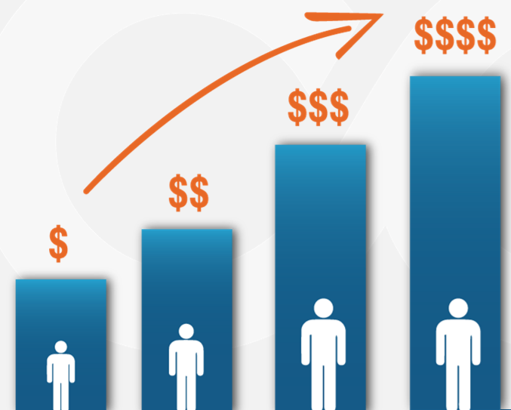
Customer Lifetime Value Auto Insurance

Slide 2

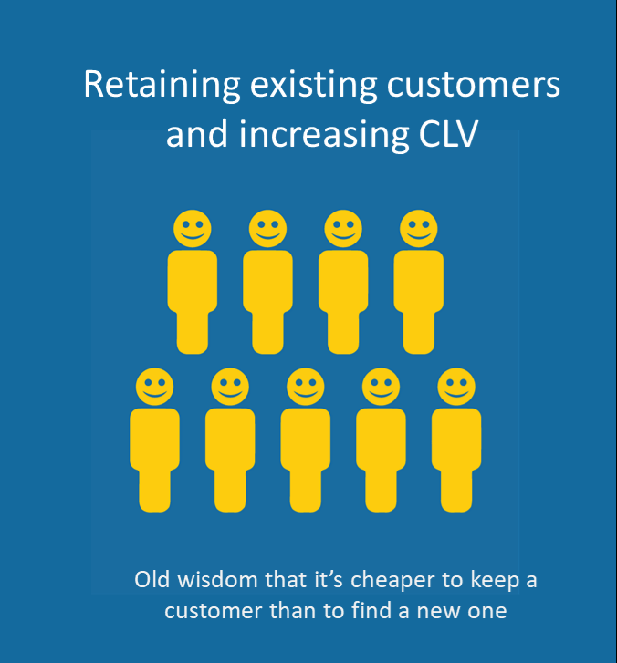
When its come to growing your business there are essentially two tactics at you disposal :

Slide 3
“The Purpose of a business is to create a customer and grow that customer”
-Peter Drucker

Slide 4
Objectives
Analysing the core factors(variables) which are responsible in affecting the CLV.
Predicting the future CLV for each customers to gain insight to make right approach in business decision.
Developing a business model to guide company in making better products and also rejuvenate the old ones.

Slide 5
The Significant Variables
Monthy_Premium_Auto
Policy
Number_of_Open_Complaints
Months_Since_Last_Claim
Income
EmploymentStatus
Customer_Lifetime
Value
Education
Policy_Type
Marital_Status
Renew_Offer_Type
Number_of_Policies
Gender
Months_Since_Policy_Inception

Slide 6
The Results Of Analysis
These are the variables having positive affect on the CLV :-
The customers who are well educated ,at least with a High
school degree.(Variable:-Education)
The customers with good earning i.e., their income is
sufficient to afford premium. (Variable:-Income)
The customers who are married.(Variable:- Marital_Status)
Those who are paying a monthly auto premium(Variable:-
Monthly_Premium_Auto)
Those who are having at least two insurance policies.
(variable:- Number_of_Policies)

Slide 7
The Results Of Analysis
These are the variables having negative affect on the CLV :-
The Customers who are unemployed.(Variable:-
Employment_Status)
The Customers who are male.(Variable:-Gender)
The Customers who are single.(Variable:- Marital_Status)
The Customers who have not claim their insurance since
months ago. (Variable:-Months_Since_Last_Claim)

Slide 8
The Results Of Analysis
Continue :-
The Customers who provides open complaints regarding their insurance. (Variable:Number_of_Open_Complaints)
The Customers who have a Personal Auto policy type. (Variable:-Policy_Type)
The Customers with Corporate L3 policy .(Variable:-
Policy)
The Customers with Renew offer type of Offer 2.
(Variable:-Renew_Offer_Type)

Slide 9
Business Recommendations
The insurance company should focus more on the customers who are at least a high school pass out.
Insurance company should target customers with a good income.
Insurance company should pay more attention towards married customers. On contrary, customers who are single have negative impact on the CLV.
Company should consider more those customers who are paying premium on monthly basis.

Slide 10
Business Recommendations
Those customers ,who hold two or more number of policies are the one to stay for a long time with the company.
The company need not consider those customers who are unemployed.
When considering customers on the basis of gender
specially Male, they tends to have a negative relation
with CLV.
Those customers who aren’t claiming their insurance for a considerable amount of time are the one who might not stick to the same company for long duration.

Slide 11
Business Recommendations
The customers who have come a long stride forward with policy’s effective date tends to have negative impact on CLV.
The most important aspect of any company is to solve their customer’s grievances. The customers with a lot of complaints forms a negative relation with company. If their issue isn’t resolved then they might not further buy any other insurance claim.
The customers with policy type of personal auto forms a negative relation with CLV.

Slide 12
Business Recommendations
The customers who renew their offer specially offer 2 are the one who are having a negative relationship with the company. This may be with some terms and clauses which they find inconvenient in the renewed offer.
The Customers with Corporate L3 Policy shows negative relationship to CLV. So, company should reconsider their terms and condition .And come up with a better version of this policy.

Slide 13
Thank You !!!

